Slide 1


ILLUMINATION-GUIDED INVERSE RENDERING BENCHMARK: LEARNING REAL OBJECTS WITH FEW CAMERAS
Vision and Graphics Lab
Doğa Yılmaz -- Furkan Kıraç
Department of Computer Science
Özyeğin University
1 September 2023

Slide 2
Outline
Introduction
Methodology
Results and Discussion
Conclusion

Slide 3
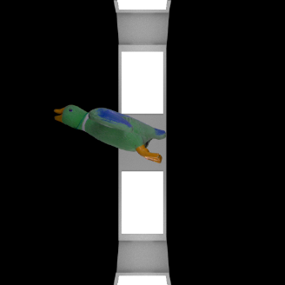
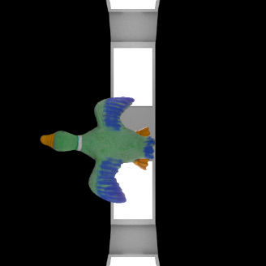
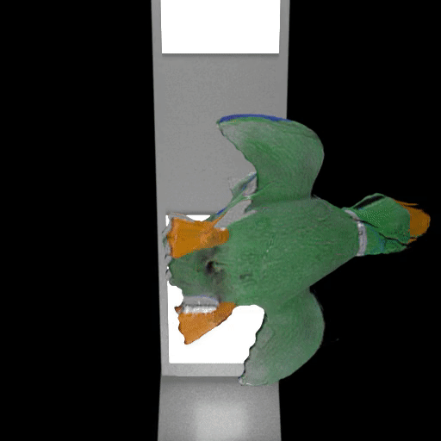
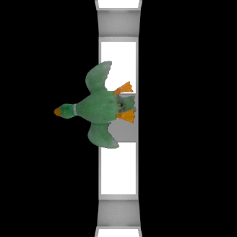
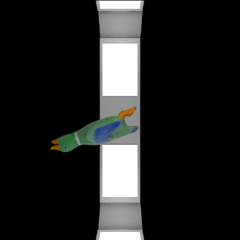
What is our goal?
Input Images
3D Reconstruction

Slide 4
Introduction: Current State of the Literature
Various approaches exist to achieve conversion between the virtual and real world.
Current methods can achieve high fidelity 3D reconstruction but there are several limitations.
There is a noticeable deficiency of real-world data that captures camera, lighting, and scene parameters.

Slide 5
Introduction: Contributions
Adapting 3D Reconstruction to real-world scenarios.
A method to capture real-world scenes as virtual ones with illumination data.
Demonstrate the impact of including light information in the scene optimization process.

Slide 6
Outline
Introduction
Methodology
Results and Discussion
Conclusion

Slide 7
Methodology: Creating Virtual Scenes
Creating Virtual Scenes via Video
Creating Virtual Scenes via Multiple Cameras

Slide 8
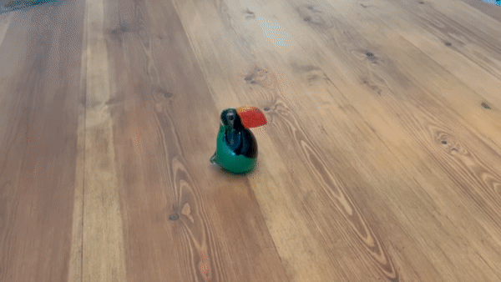
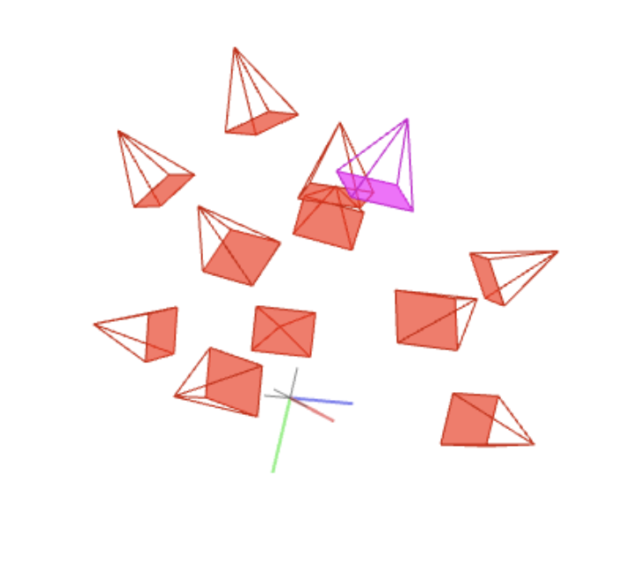
Methodology: Creating Virtual Scenes via Video
Structure From Motion
(COLMAP)
Input Video
Viewpoints

Slide 9
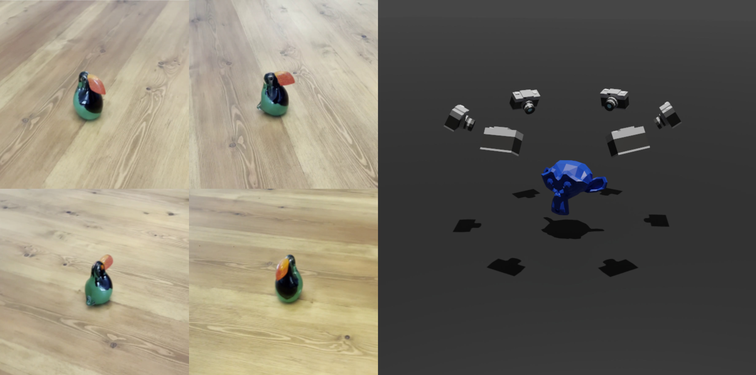
Methodology: Creating Virtual Scenes via Video
Input Images
Virtual Scene

Slide 10
Methodology: Creating Virtual Scenes via Video
Advantages
Simple and easy to apply
Does not require any sophisticated equipment
Disadvantages
Does not capture illumination parameters of the scene.
Does not capture the surroundings
Requires to estimate the camera location and direction parameters
The images are not synchronized

Slide 11
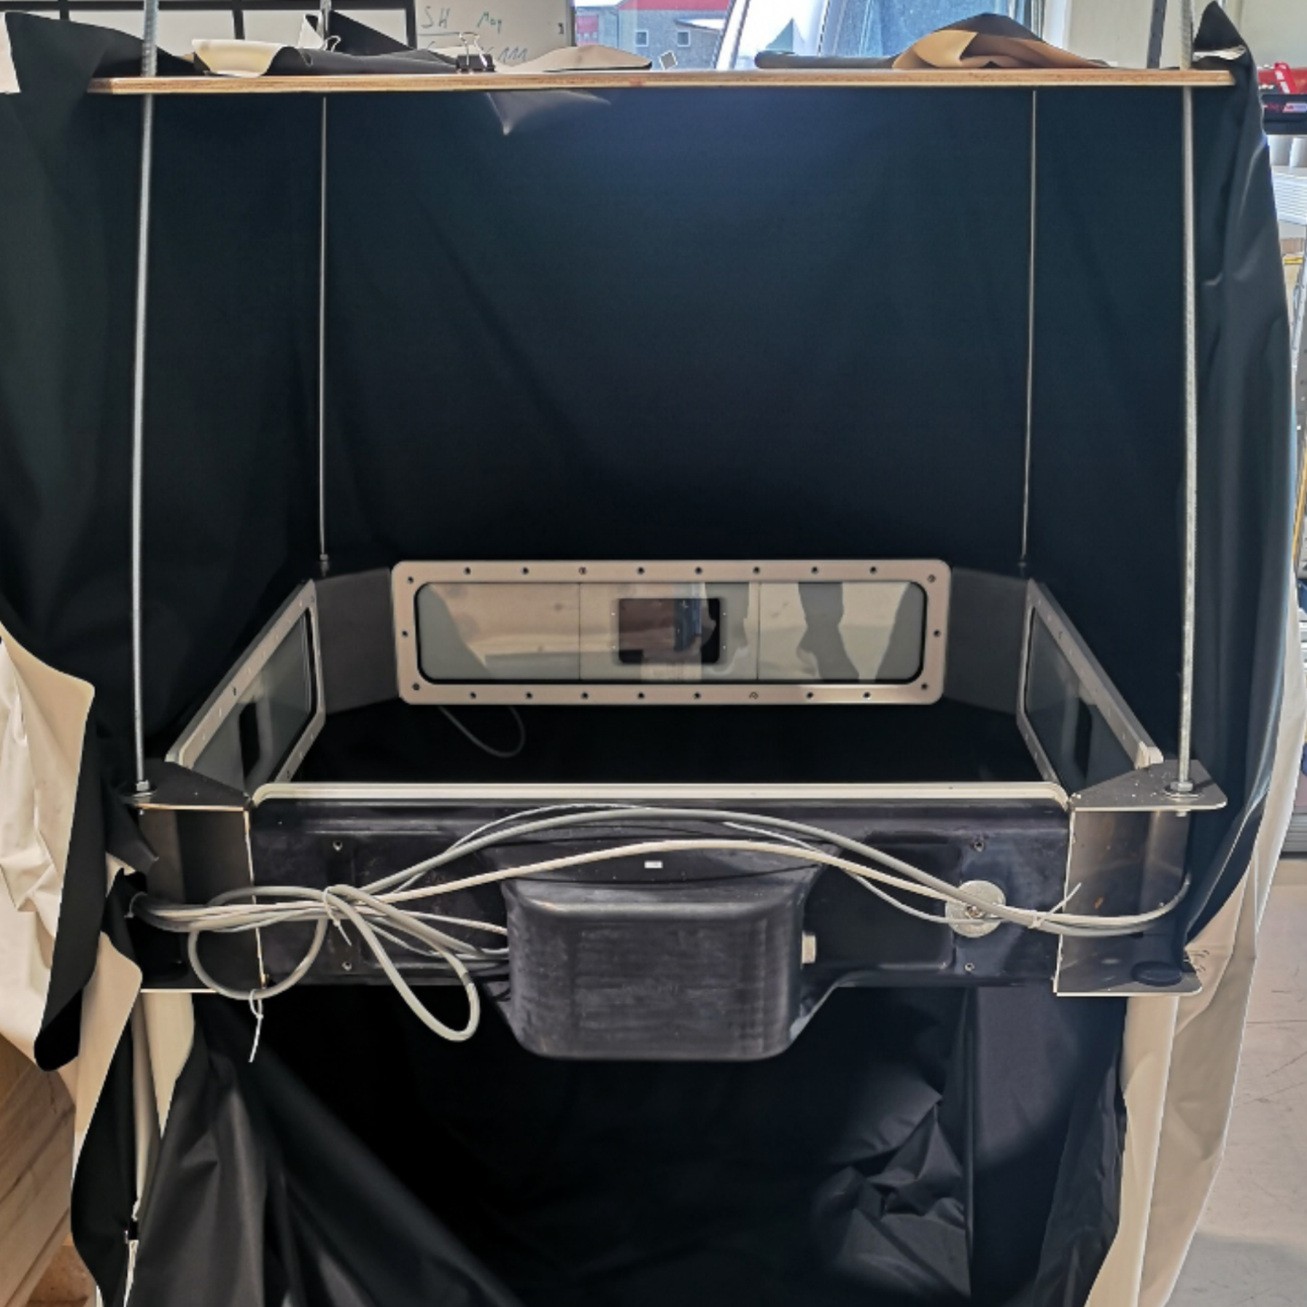
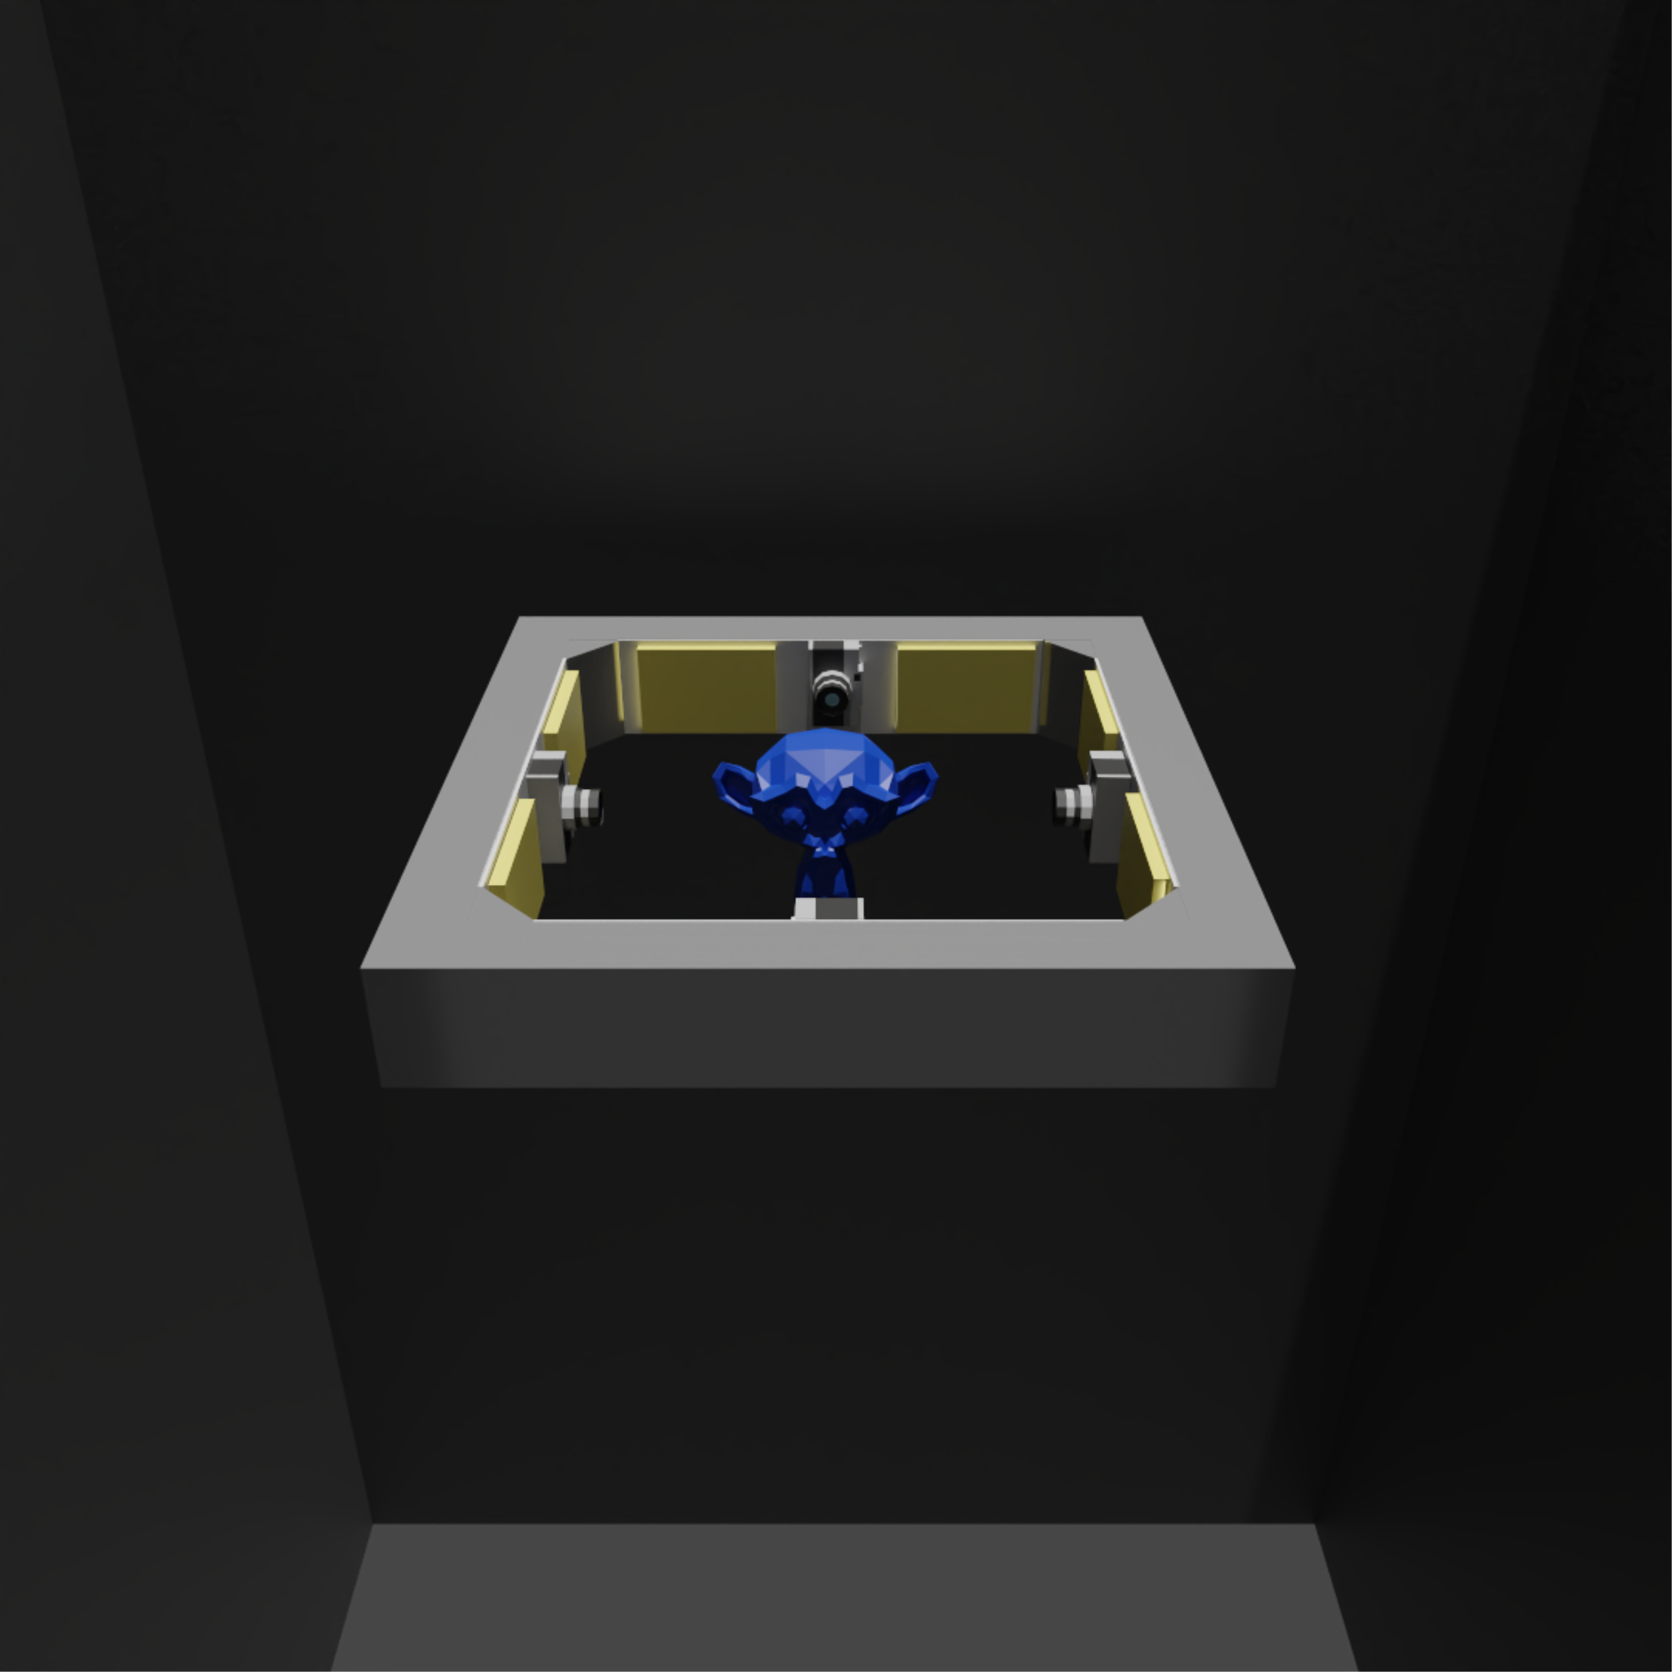
Methodology: Creating Virtual Scenes via Multi-Cam
Real Scene
Virtual Scene

Slide 12
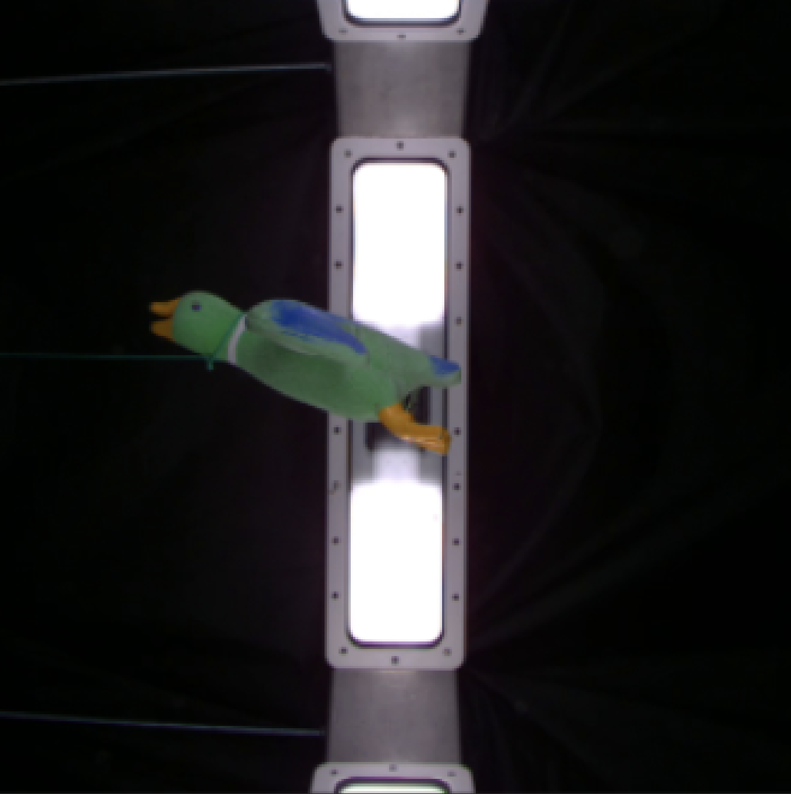
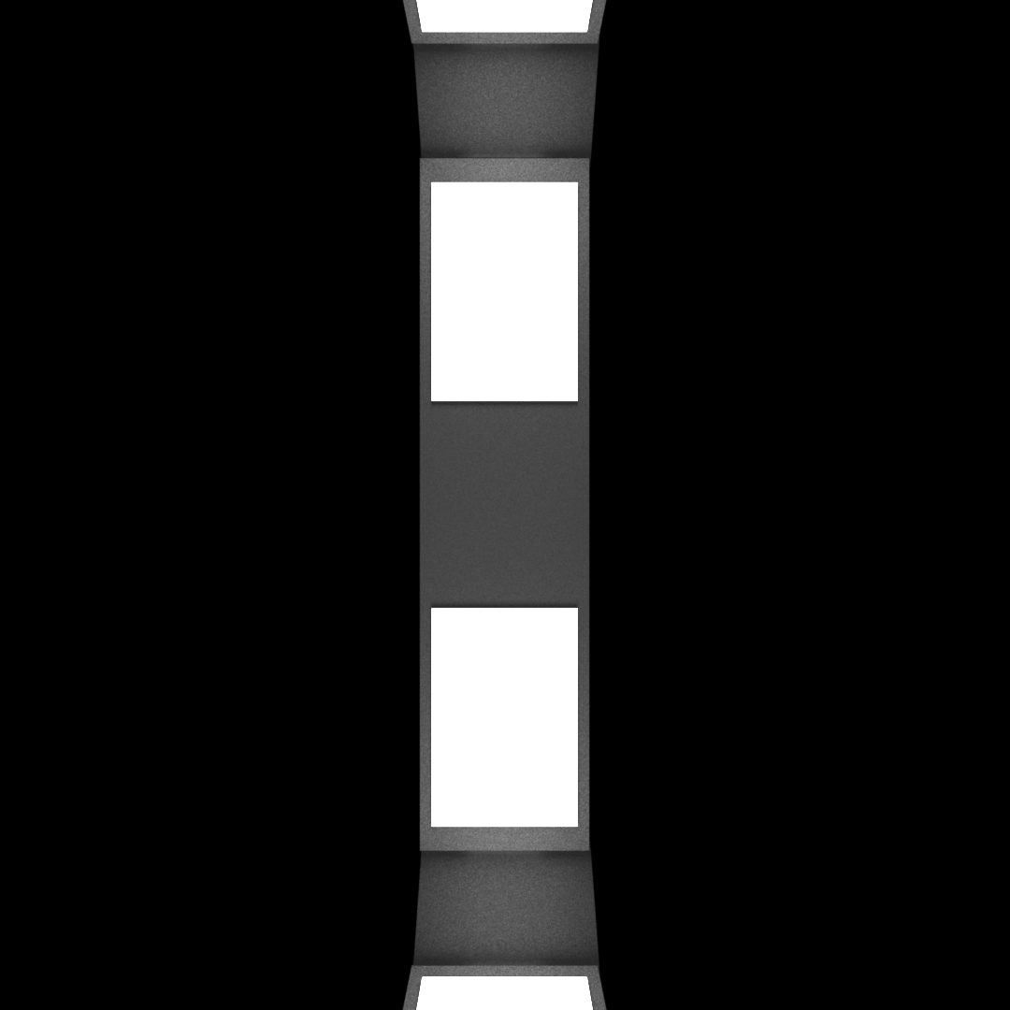
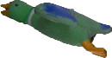
Methodology: Creating Virtual Scenes via Multi-Cam
Real Image
Rendered Image

Slide 13
Methodology: Creating Virtual Scenes via Multi-Cam
Rendered Images with
Target Object Segments
Virtual Scene

Slide 14
Methodology: Creating Virtual Scenes via Multi-Cam
Advantages
Captures illumination parameters alongside with other scene parameters
Captures reflections form surroundings
Captured images are synchronized
Disadvantages
Requires multiple cameras
Compared to other method it is harder to apply in real world.

Slide 15
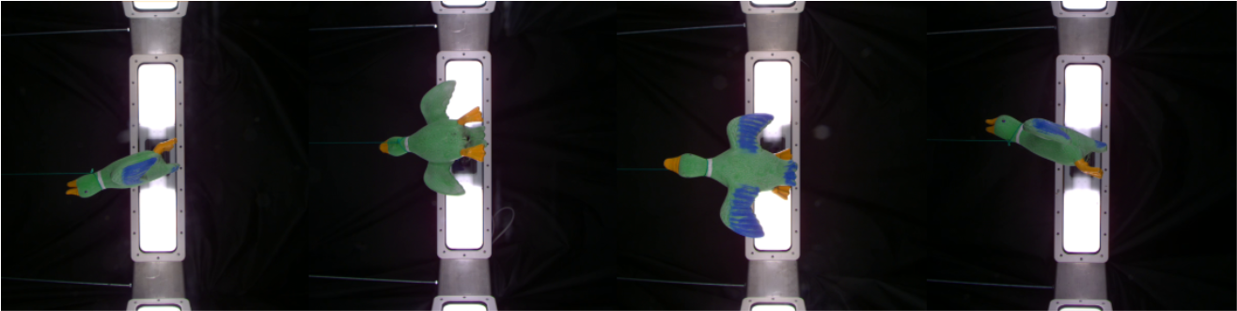
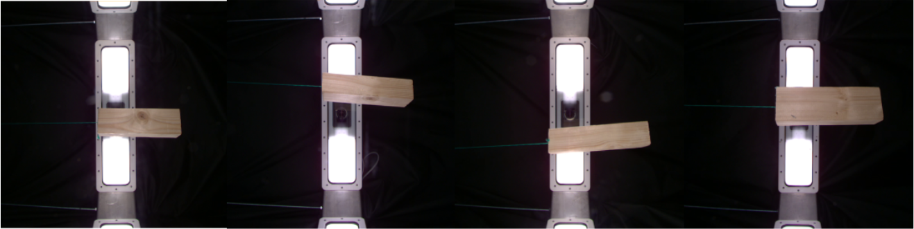
Methodology: Benchmark Scenes
Scene Count: 10
Scene Type: Real
Are Images Synchronized: Yes
Included Scene Data: Image, camera , illumination, surroundings
The Duck
Box Wooden

Slide 16
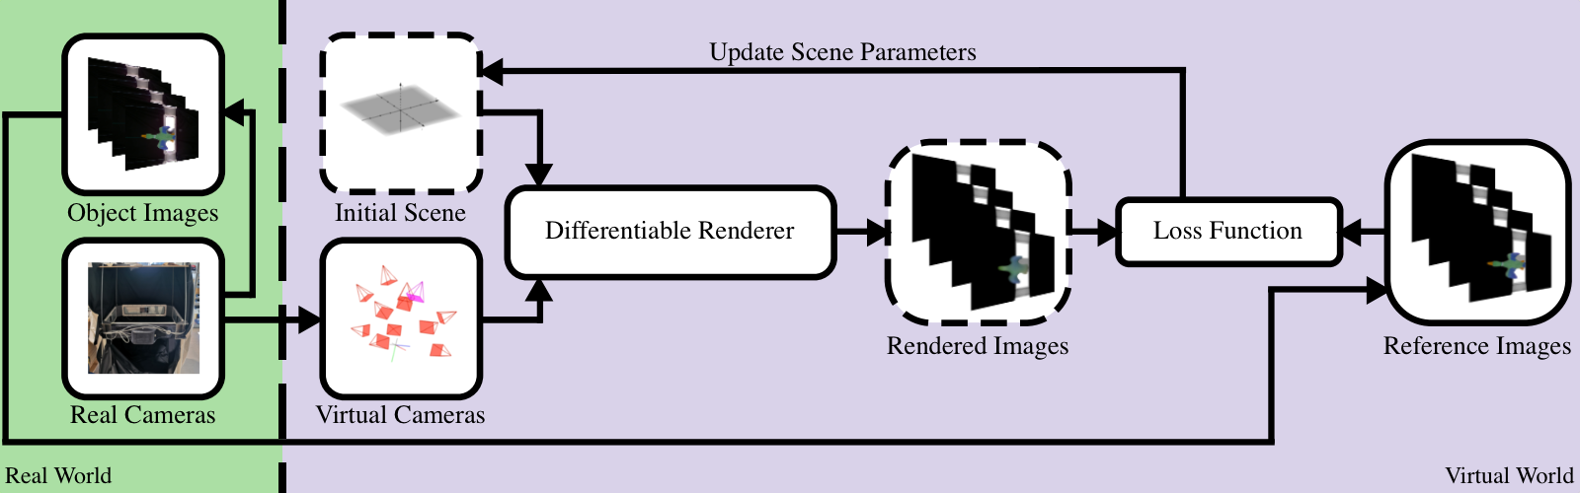
Methodology: 3D Reconstruction for Real-World Objects
Our 3D Reconstruction Pipeline

Slide 17
Methodology: Loss Functions
L1
L2
Multiscale L1
Multiscale L1 + SSIM
Multiscale L1 + Silhouette

Slide 18
Outline
Introduction
Methodology
Results and Discussion
Conclusion

Slide 19
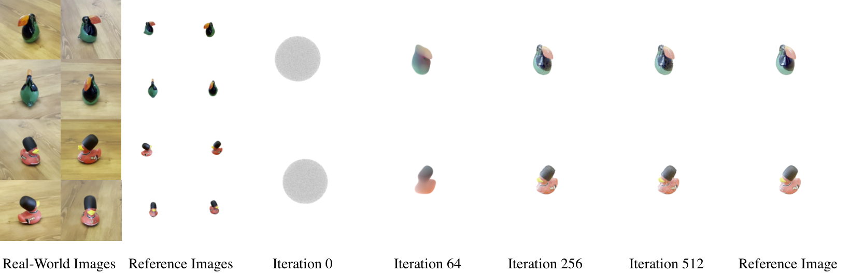
Results: Single Turntable Video Setup
Convergence

Slide 20
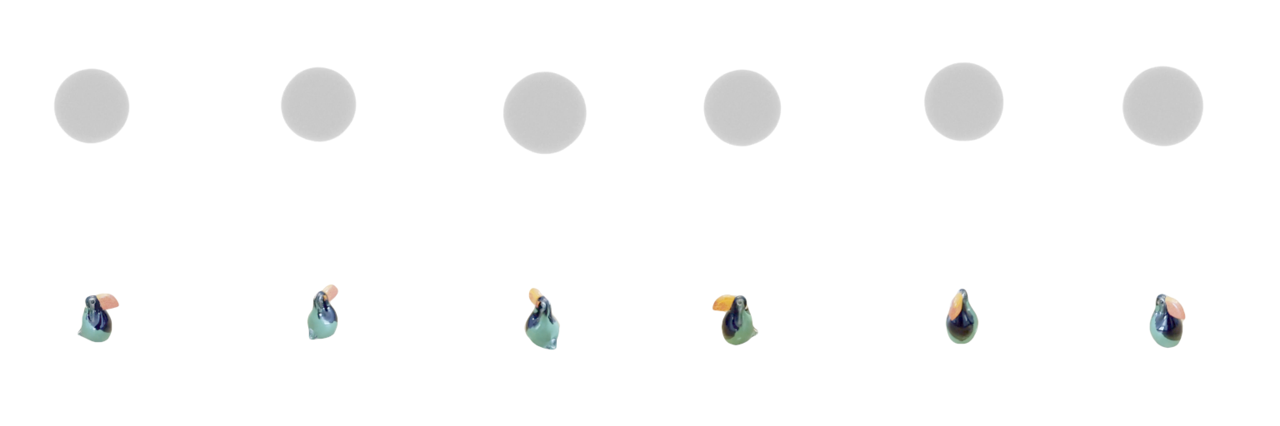
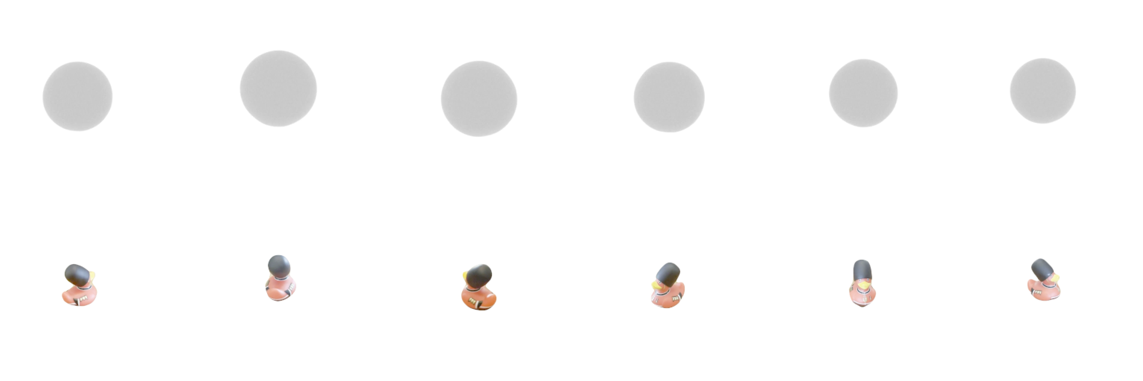
Results: Single Turntable Video Setup
Convergence Video of The Toucan Scene
Convergence Video of The Rubber Duck Scene

Slide 21
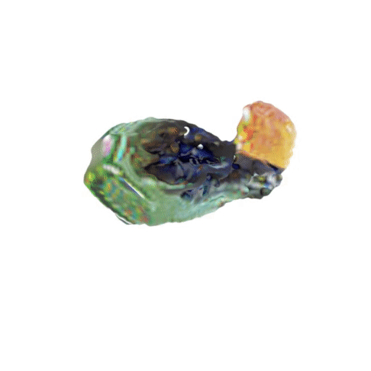
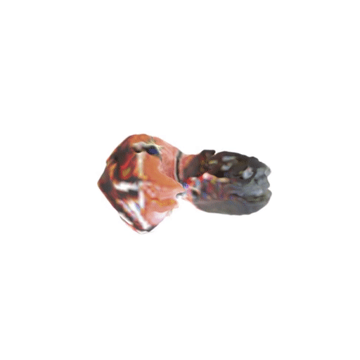
Results: Single Turntable Video Setup
The Toucan
The Rubber Duck

Slide 22
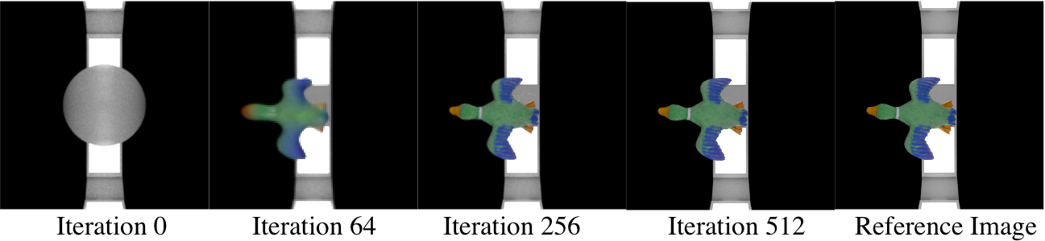
Results: Multi-Cam Setup
Convergence

Slide 23
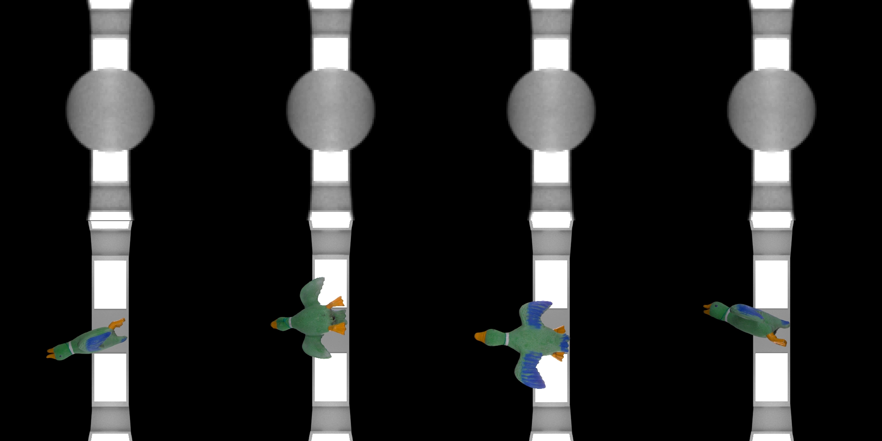
Results: Multi-Cam Setup
Convergence Video of The Duck Benchmark Scene

Slide 24
Results: Multi-Cam Setup
Resulting 3D Reconstruction

Slide 25
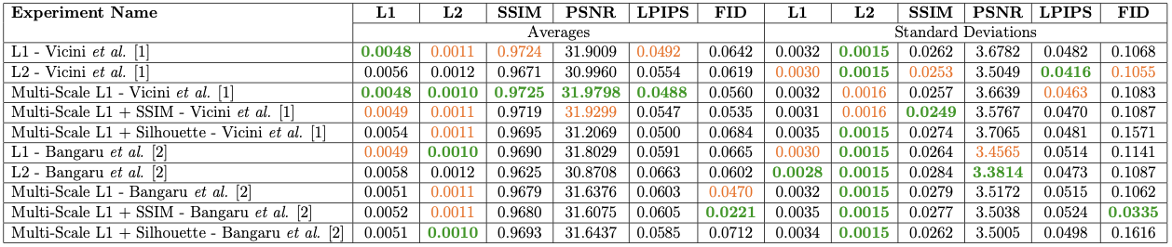
Results: Multi-Cam Setup
Quantitative results of the benchmark scenes captured using multi-camera setup

Slide 26
Results: Additional Experiments
Effects of Different Loss Functions
Effects of Number of View
Effects of Capturing Illumination
Current Limitations

Slide 27
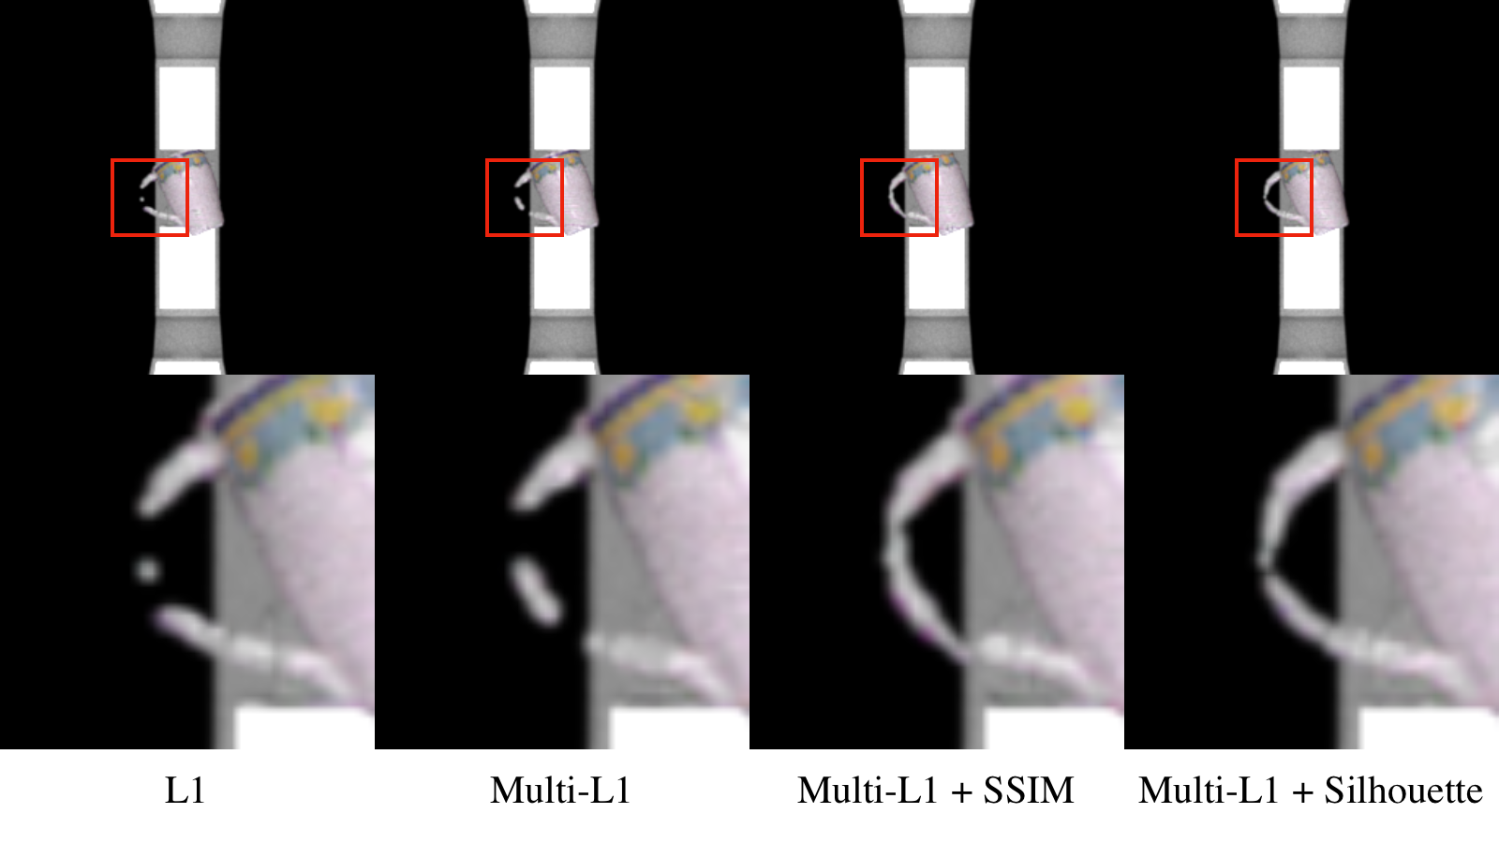
Results: Effects of Different Loss Functions

Slide 28
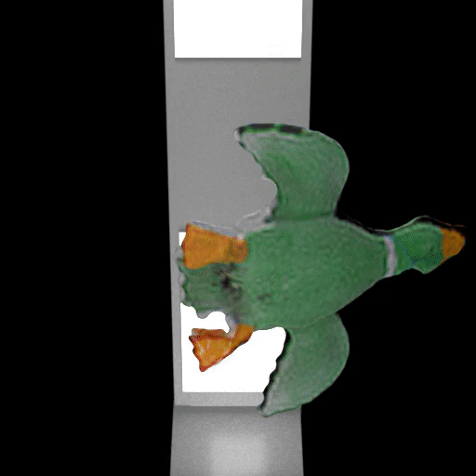

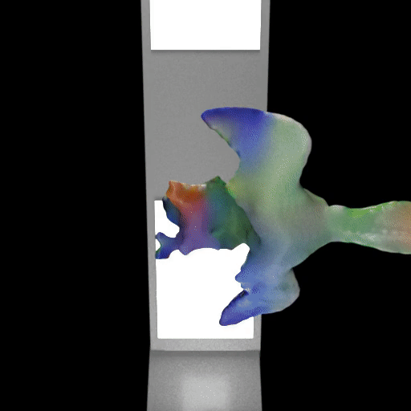
Results: Effects of Number of View
4 Camera
3 Camera
2 Camera
1 Camera

Slide 29
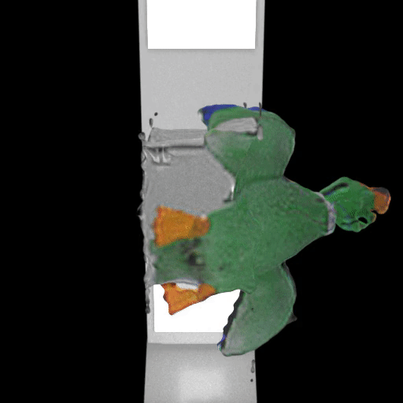
Results: Effects of Capturing Illumination
Correct Illumination
Incorrect Illumination

Slide 30
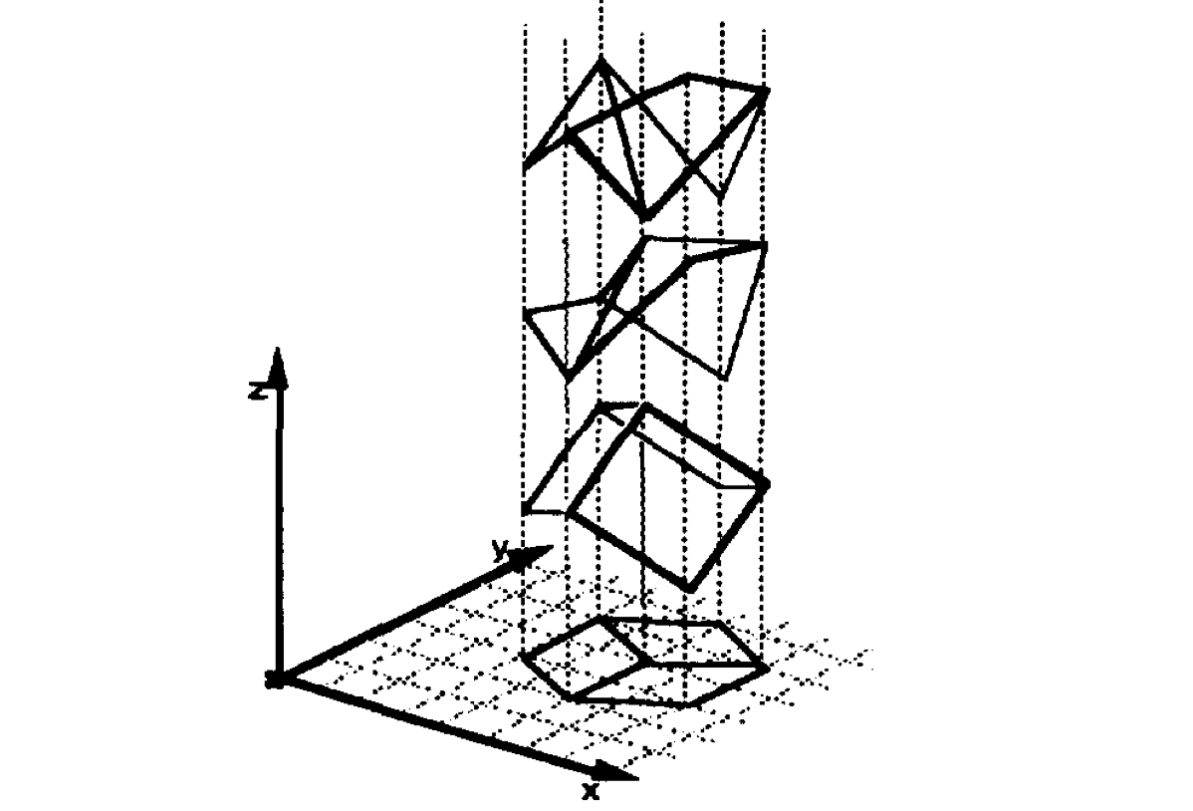
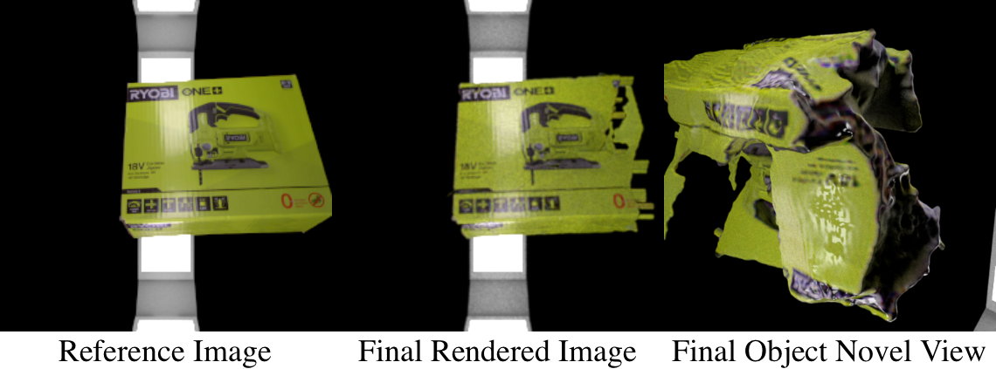
Results: Current Limitations

Slide 31
Outline
Introduction
Methodology
Results and Discussion
Conclusion

Slide 32
Discussion and Conclusion
Our empirical investigations demonstrate that in limited viewpoint scenarios, current 3D reconstruction methods can successfully retrieve the target object with an acceptable level of quality.
The inclusion of illumination data notably enhances the fidelity of the resulting reconstructions.
Potential improvement lies in the addition of 3D mesh and texture evaluation methods.

Slide 33
Vision and Graphics Lab
Thank you for your time.

